Slide 1
IndyML

Slide 2
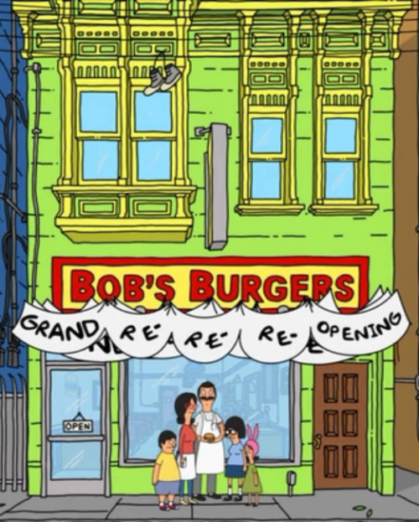

Slide 3
Plan going forward
Complete a segment on text analytics
Part of speech tagging and entity extraction
Sentiment Analysis
Document Classification
Google’s TensorFlow
Word2Vec
Questions answer engine
Next segments
TensorFlow
Let me know if you’d like to share
Full Session
Lightning talks

Slide 4
A little about me
Data scientist and data illustrator at First Analytics
Machine Learning / TensorFlow
Text Analytics
Image Recognition
Livingwithdata.com
Masters in Analytics from Northwestern
New to Indy
Outside of data
Running and Photography

Slide 5
Outline for tonight
Why text analytics
Turning unstructured data into something structured
Analyzing the data
Example code

Slide 6
Why text analytics
Majority of data is unstructured
Interesting
Challenging
Distinguishing

Slide 7
Turning the unstructured to structured
Tokenize: split the text into the individual words
Stem: Change words into their base word (e.g., Having becomes Have)
TFIDF: A data frame that we can then perform analysis on

Slide 8
Example
Raw Text
“The quick brown fox jumps over the lazy dog.”
Tokenize
“the”, “quick”, “brown”, “fox”, “jumps”, “over”, “the”, “lazy”, “dog”
Stem
“jumps” becomes “jump”

Slide 9
Example TFM
Input
“the”, “quick”, “brown”, “fox”, “jump”, “over”, “the”, “lazy”, “dog”
the | quick | brown | fox | jump | over | lazy | dog
2 | 1 | 1 | 1 | 1 | 1 | 1 | 1

Slide 10
TF-IDF
The quick brown fox jumps over the lazy dog
the | quick | brown | fox | jump | over | lazy | dog
0.14 | 0.30 | 0.23 | 0.68 | 0.4 | 0.24 | 0.50 | 0.20

Slide 11
Process
Raw Text
TFIDF
Stats
Classification
Clustering

Slide 12
Coding Example
1. Scrape data from a website (character dialog from a show)
2. Tokenize, Stem, and create a TFIDF
3. Run a simple classifier on the data
4. Identify each character’s most identifiable words

Slide 13


